Slide 1
Your logo here
Notes:
Intro slide, must come at very beginning. Add your logo to the right (no larger than USAID logo, keep all letters equal height to USAID)

Slide 2
Your logo here
Partner’s logo
Notes:
Intro slide, must come at very beginning. Add your logo, and partner’s logo to the right (no larger than USAID logo, keep all letters equal height to USAID)

Slide 3
Notes:
Black&white version of Horticulture Innovation Lab logo block intro slide

Slide 4
Notes:
Optional secondary slide, or may be used for dividing categories. Note: FEED THE FUTURE space relationship to “Innovation Lab for Horticulture” reads together as: Feed the Future Innovation Lab for Horticulture, and thus does not require redundant adding of words “Feed the Future” in addition to the logo “FEED THE FUTURE”

Slide 5
Your logo here
Notes:
May add your logo to the far right, letters in logo must be no higher than USAID (no logo must be larger than Feed the Future or USAID)

Slide 6
Your logo here
Partner’s logo
Notes:
May add your logo and partner’s logo to the far right, letters in logo must be no higher than USAID (no logo must be larger than Feed the Future or USAID)

Slide 7
General Branding reference
Notes:
Slide may be used to divide categories

Slide 8
Feed the Future Innovation Lab for Horticulture
(also known as Horticulture Innovation Lab)
Branding & Communications guides
USAID Branding
Feed the Future Branding Guidelines
Horticulture Innovation Lab Branding & Communications

Slide 9
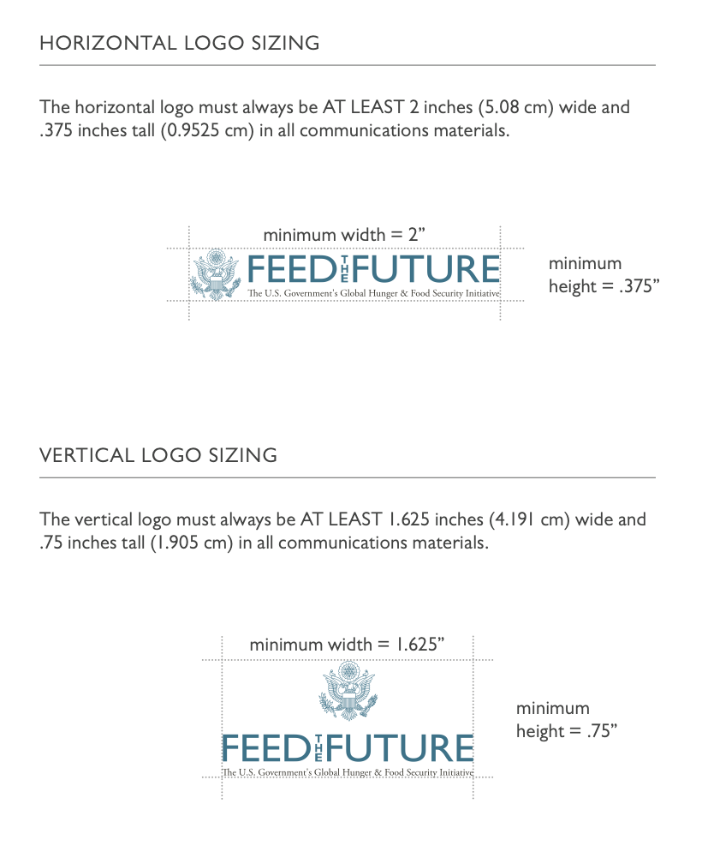
Feed the Future – logo use
Refer to pages 15, 17 here: https://cg-281711fb-71ea-422c-b02c-ef79f539e9d2.s3.us-gov-west-1.amazonaws.com/uploads/2015/01/Feed-the-Future-Graphic-and-Naming-Standards-Manual.pdf

Slide 10
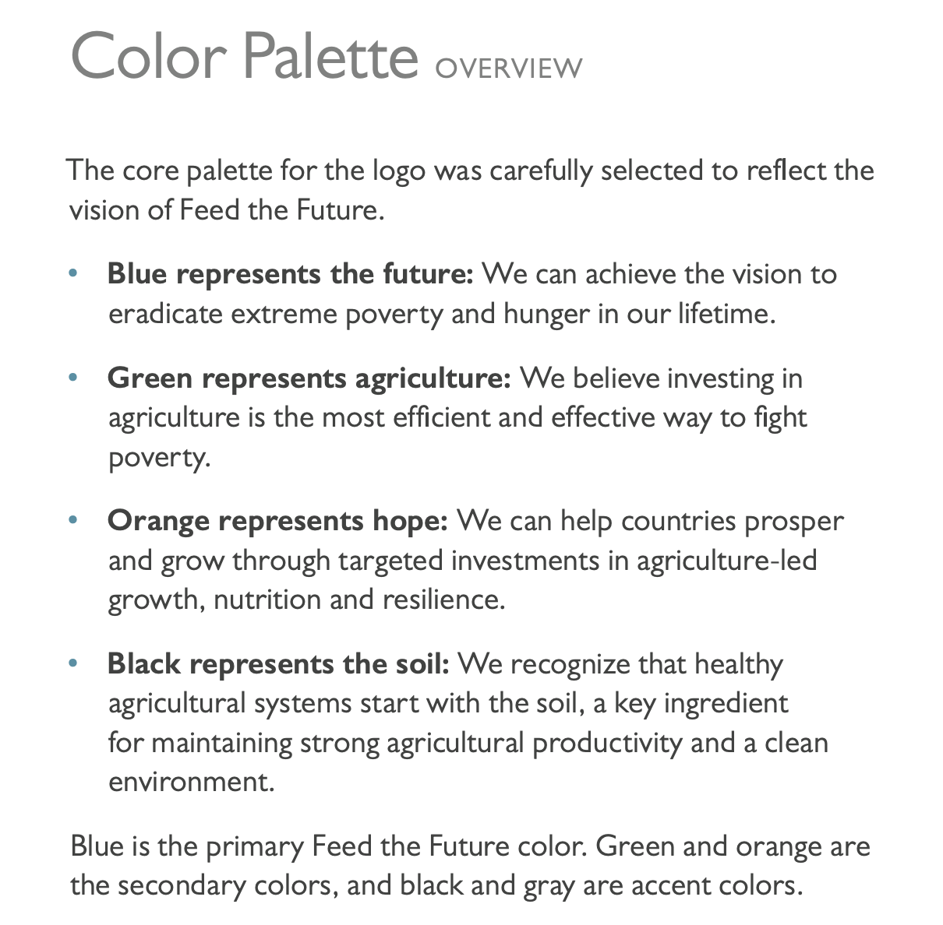
Feed the Future – color palette
Refer to pages 18-19 here: https://cg-281711fb-71ea-422c-b02c-ef79f539e9d2.s3.us-gov-west-1.amazonaws.com/uploads/2015/01/Feed-the-Future-Graphic-and-Naming-Standards-Manual.pdf

Slide 11
Feed the Future
Refer to pages 20, 22-3 of Feed the Future Branding Guide at: www.feedthefuture.gov/branding

Slide 12
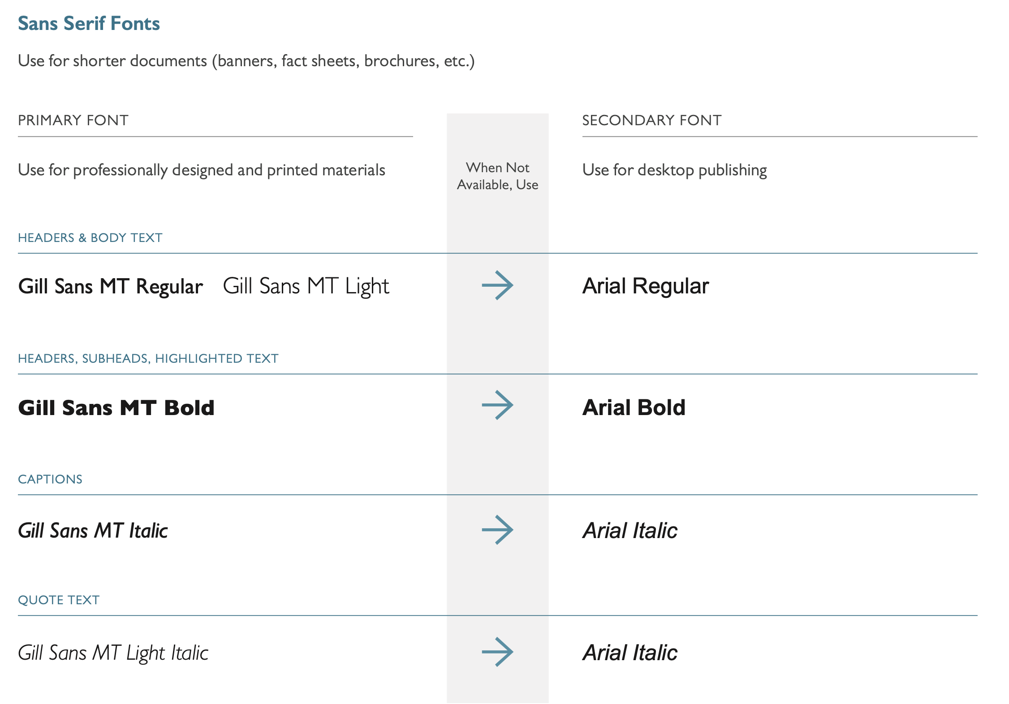
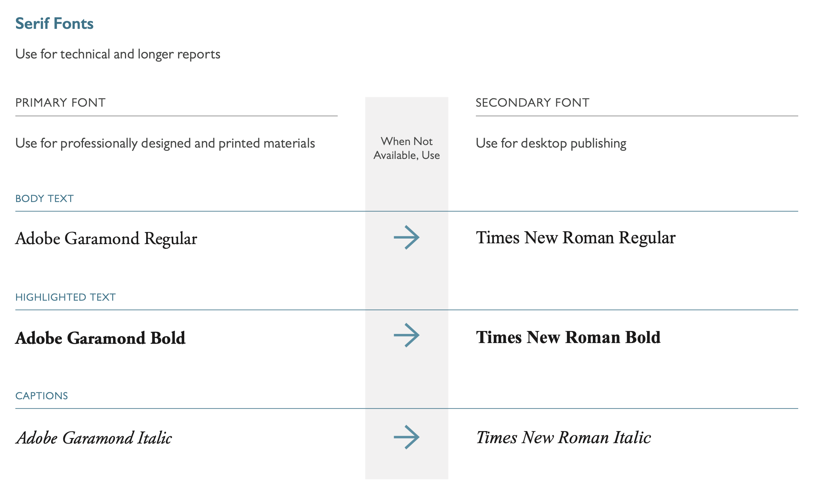
Feed the Future
Refer to pages 20, 22-3 of Feed the Future Branding Guide at: www.feedthefuture.gov/branding

Slide 13
Always Include Disclaimer Language
Per USAID-regulations, all USAID-funded public communications must incorporate an appropriate disclaimer to make it clear that the communication is USAID-funded, but does not constitute USAID corporate communications.
Below is an example of disclaimer language to include in your materials:
This program is made possible by the generous support of the American people through the United States Agency for International Development (USAID). The contents are the responsibility of the Feed the Future Innovation Lab for Horticulture, West Africa Regional Hub based at the University of Ghana, and do not necessarily reflect the views of USAID or the U.S. Government.
Citation: Page 42 of the Feed the Future Graphic and Naming Standards Manual, available at: feedthefuture.gov/resource/feed-the-future-graphic-and-naming-standards-manual/

Slide 14
Primary Color HEX# 237C9A
Notes:
Slide may be used to divide categories

Slide 15
Secondary Color HEX# 518325
Notes:
Slide may be used to divide categories

Slide 16
Secondary Color HEX# C25700
Notes:
Slide may be used to divide categories

Slide 17
Your logo here
Notes:
Slide to close presentation. Note: disclaimer language acknowledging funder. May add white version of your logo to the far right

Slide 18
Your logo here
Partner’s logo
Notes:
Slide to close presentation. Note: disclaimer language acknowledging funder. May add white version of your logo and partner’s logo to the far right

Slide 19
Notes:
Slide to close presentation option, featuring Horticulture Innovation Lab logo block + all Regional Hubs in alphabetical order

Slide 20
Notes:
Slide to close presentation black&white option

Slide 21
Your logo here
Notes:
Presentation closing slide, may add your logo to the right (letters no taller than USAID logo letters)

Slide 22
Your logo here
Partner’s logo
Notes:
Presentation closing slide, may add your logo and partner’s logo to the right (letters no taller than USAID logo letters)

