Slide 1
Heading
Sub Heading
Paragraph Header
Filler text, filler text filler text filler text Filler text, filler text filler text filler text Filler text, filler text filler text filler text Filler text, filler text filler text filler text Filler text, filler text filler text filler text Filler text, filler text filler text filler text Filler text, filler text filler text filler text Filler text, filler text filler text filler text Filler text, filler text filler text filler text Filler text, filler text filler text filler text Filler text, filler text filler text filler text Filler text, filler text filler text filler text Filler text, filler text
filler text filler text Filler text, filler text filler text filler text Filler text, filler text filler text filler text Filler text, filler text filler text filler text Filler text, filler text filler text filler text Filler text, filler text filler text filler text Filler text, filler text filler text filler text Filler text, filler text filler text filler text Filler text, filler text filler text filler text Filler text, filler text filler text filler text Filler text, filler text filler text filler text Filler text, filler text filler text filler text Filler text, filler text filler text filler text Filler text, filler text filler text filler text Filler text.
Paragraph Header
filler text Filler text, filler text filler text filler text Filler text, filler text filler text filler text Filler text, filler text filler text filler text Filler text, filler text filler text filler text Filler text, filler text filler text filler text Filler text, filler text filler text filler text Filler text, filler text filler text filler text Filler text. Filler text, filler text filler text filler text Filler text
Image goes here
Image
Caption text, describe picture, name place, purpose, image credit whenever possible.
filler text filler text Filler text, filler text filler text filler text Filler text, filler text filler text filler text Filler text, filler text filler text filler text Filler text, filler text filler text filler text Filler text, filler text filler text filler text Filler text, filler text filler text filler text Filler text, filler text filler text filler text Filler text, filler text filler text filler text Filler text, filler text filler text filler text Filler text, filler text filler text filler text Filler text, filler text filler text filler text Filler text, filler text filler text filler text Filler text, filler text filler text filler text Filler text. Filler text, filler text filler
This form is made possible by the generous support of the American people through the United States Agency for International Development (USAID). The contents are the responsibility of the Feed the Future Innovation Lab for Horticulture [YOUR PROJECT/ASK IF UNSURE] and do not necessarily reflect the views of USAID or the U.S. Government.
your website url here
Title // contact info Name(s) email@organization.edu .org etc.
Your logo here
Your partner logo
Notes:
Generous clear-spacing around logos (p. 16) www.feedthefuture.gov/resource/feed-the-future-graphic-and-naming-standards-manual/.
Example of Factsheet (p. 40) www.feedthefuture.gov/resource/feed-the-future-graphic-and-naming-standards-manual/.
Use Feed the Future brand colors and fonts: Primary blue (HEX# 237C9A) and Gill Sans. Refer to required fonts and colors on this webpage: horticulture.ucdavis.edu/branding-communications.
For how to customize PPT dimensions: support.microsoft.com/en-us/office/change-the-size-of-your-slides-040a811c-be43-40b9-8d04-0de5ed79987e.
For how to resize a picture, shape, text box, or other object: support.microsoft.com/en-us/office/resize-a-picture-shape-text-box-or-other-object-f9d717a8-b0b2-41b4-85be-e34ba28a949a.

Slide 2
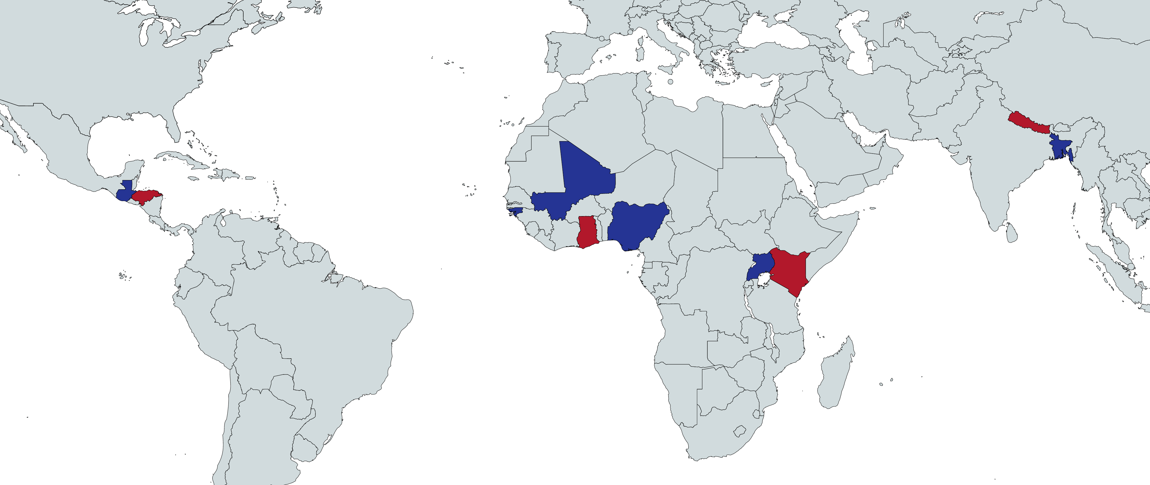
Countries with Research Activities
In the map above, countries where the Horticulture Innovation Lab has a Regional Hub and research activities are indicated with solid red, blue are countries with just research activities.
Our Consortium
University of California, Davis is joined in a consortium with Florida A&M University, Michigan State University, Texas A&M University, and the World Vegetable Center, along with subject matter experts from Penn State University and Making Cents International, to help manage this program.
Updated 17 November 2023

